Slide 1

Crime Reporting System

Slide 2
Project Presentation Outline
Abstract
Introduction
Problem Statement
Survey of Existing Systems
Project Objectives
Requirement Analysis
Solution Proposed
Models and Diagrams
The Implementation
The Outcome Discussion
Conclusions and Limitations

Slide 3
Abstract
“Online Crime Reporting System” is a system which provides online communication of citizens with the police.
This system allows features such as registering a complaint online, getting information about criminals and direct communication with police authorities.

Slide 4
Introduction
“Online Crime Reporting System” is a web application based on Java.
This system is aimed to facilitate the citizens online communication with the various police departments.
The system can be accessed by anyone, anytime and from anywhere, which makes it quite important in the case of emergency.
This system will provide records of declared criminals along with their photos and details.

Slide 5
The Problem Statement
The present system are now made online but they lack some features such as -
Uploading of documents.
No Proper description of criminals i.e. photos.
No Online communication between departments.
No Separate accounts for departments

Slide 6
Survey of Existing Systems
Existing systems are less interactive.
No facility of email alerts and direct communication.
No department to Department communication.
Less transparency

Slide 7
Objectives
OCRS is an online crime reporting and criminal record system.
It provides the facility of complaint registration, track status and several other features.
It is created to address the lack of some features of existing online crime reporting systems

Slide 8
Functional Requirement Analysis
Crime Reporting forms, progress tracking.
Facilitate crime record search – region wise.
Recognition of citizen and other user‟s contribution in solving criminal issues.
Secure registration and profile management facilities for people and departments.
Alerts & time-to-time instructions to people through mail.

Slide 9
Non-Functional Requirements
Performance Requirements : The System should always perform in same manner irrelevant of the system‟s hardware and software configuration and should produce the same set outputs for a given set of inputs.
User Interface Requirements : The interface will be designed in such a way that it could be easily operated by any person who has little knowledge to operate computer. It should be user friendly and should not be confusing.
Security Requirements : This portal contains confidential information, so proper security measures must be carried out. Only authorized users can use the services.
Reliability Requirements : The data is stored on the server so in the case of any hardware or software failure the system must be remained unaffected and function normally .

Slide 10
Solution Proposed
The Proposed System is equipped with the following features –
Supports upload of documents.
Criminal records with photos and other details.
Equipped with a E-mail alert feature to notify and alert the users.
Provides online communication among departments and separate department accounts.
.

Slide 11
Resources
Technology : Java (JDBC-ODBC, Servlets, JSP)
Web Technologies : Html, JavaScript, CSS
IDE : NetBeans.

Slide 12
Conclusion
OCRS is developed specifically to implement some advanced latest technological reforms which are necessary in existing online complains portal.
It is based on the idea of existing online crime reporting system but implements it in a more interactive and user friendly way.

Slide 13
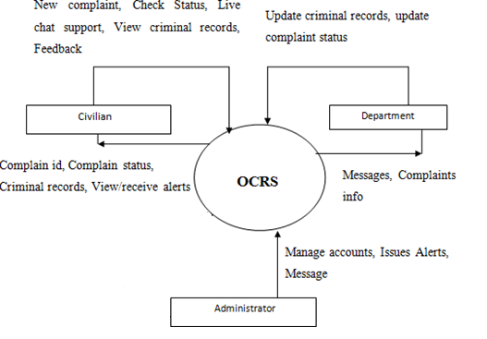
Data flow Diagrams

Slide 14
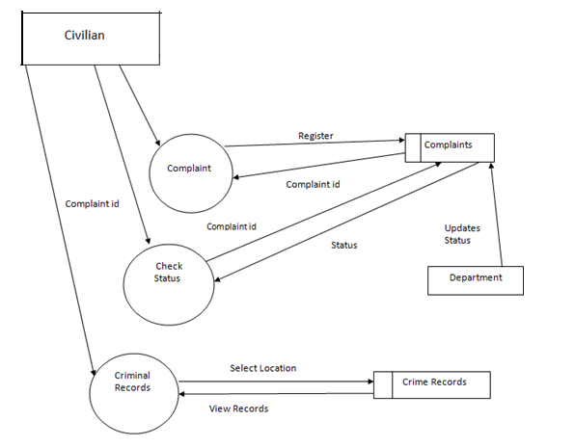
Civilian flow diagram

Slide 15
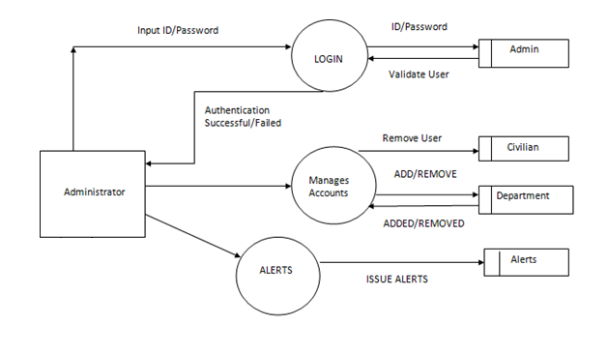
Administrator Flow Diagram

Slide 16
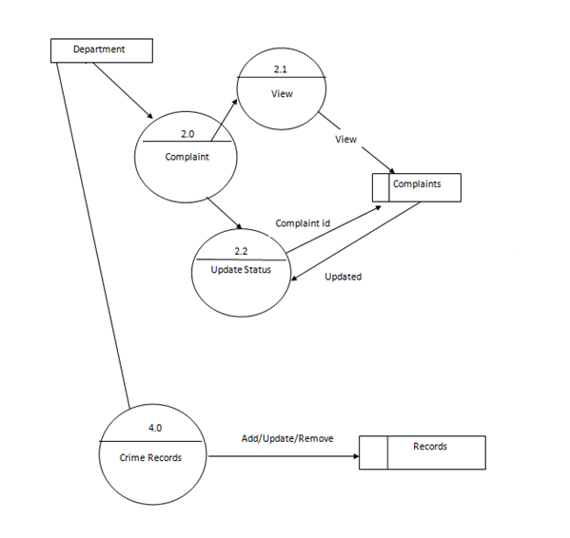
Department Flow Diagram

Slide 17
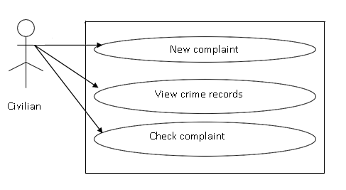
Civilian Use Case Diagram

Slide 18
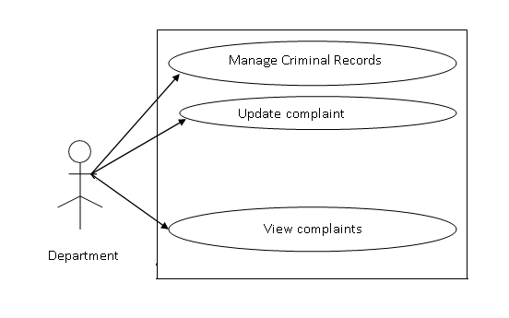
Department Use Case Diagram

Slide 19
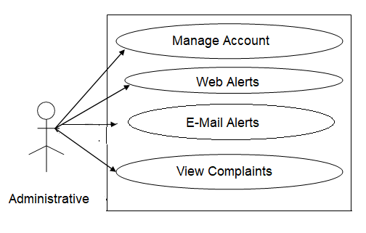
Administrator Use Case Diagram

Slide 20
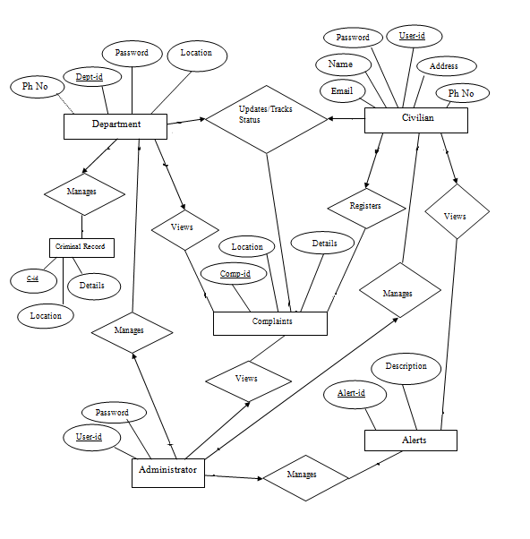
ER Diagram:

Slide 21
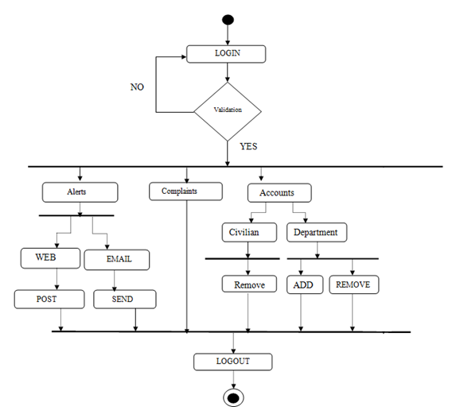
Admin Activity Diagram:

Slide 22
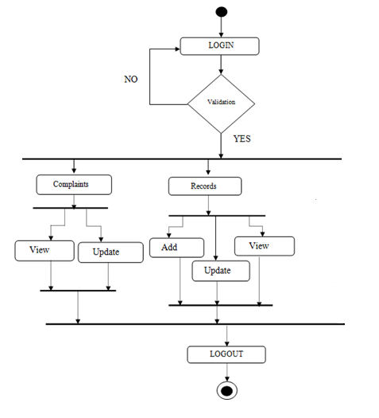
Department Activity Diagram:

Slide 23
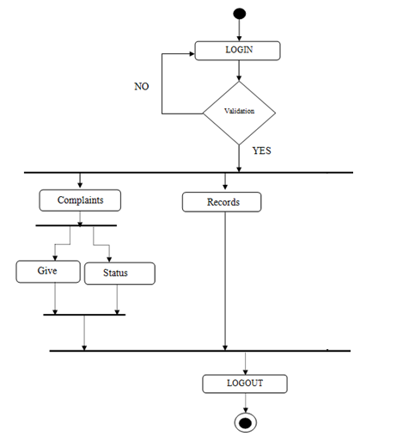
Civilian Activity Diagram:

Slide 24
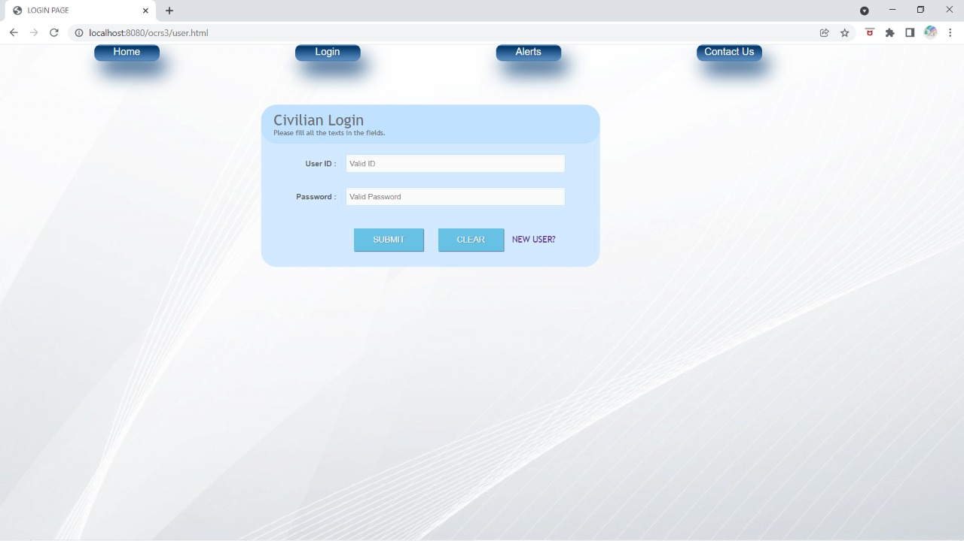
Fig. Civilian Login Page

Slide 25
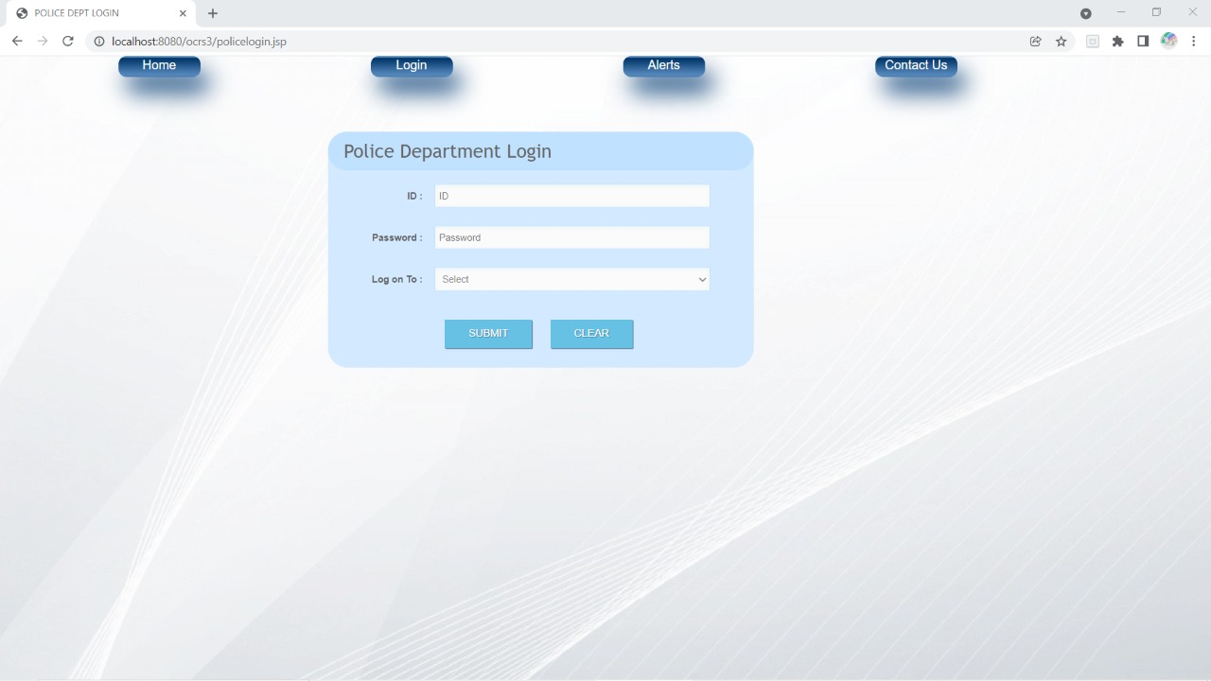
Fig Police Login Page

Slide 26
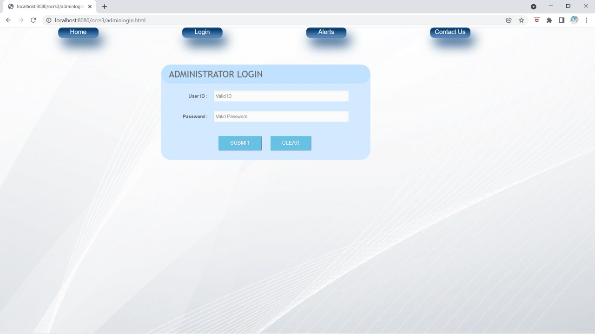
Fig Administrator Login Page

Slide 27
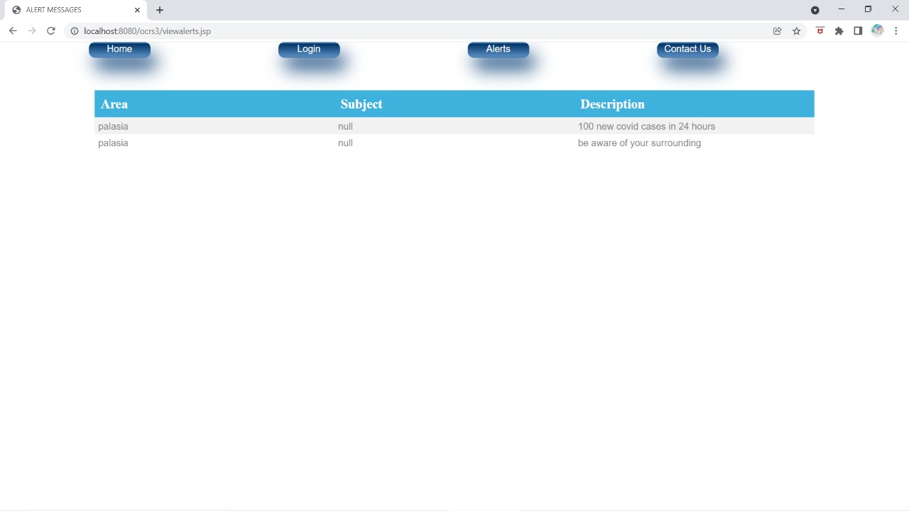
Fig Views Alert Page

Slide 28
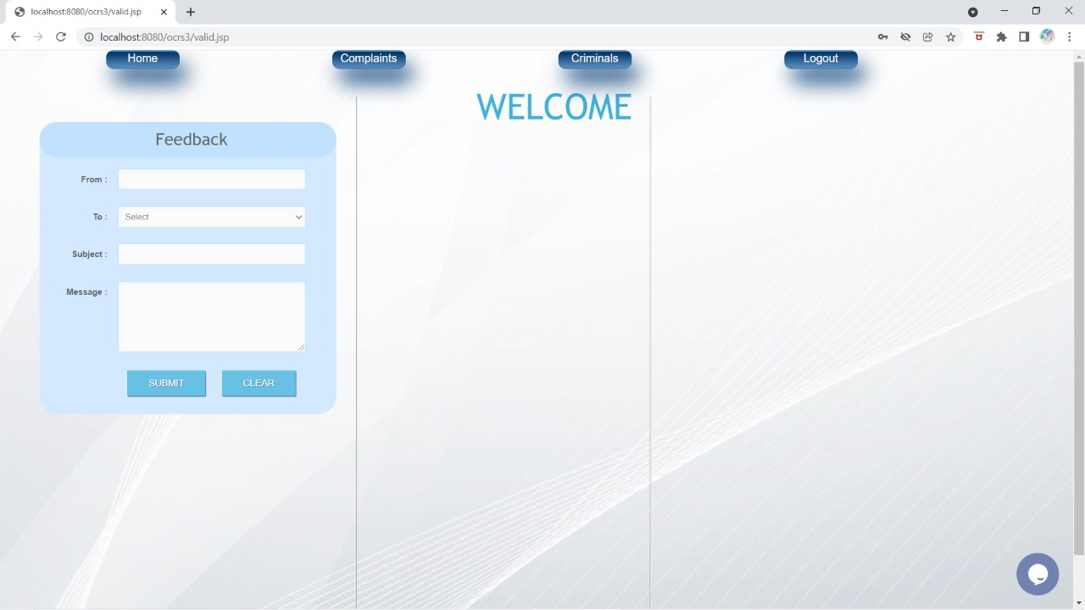
Fig Feedback Page

Slide 29
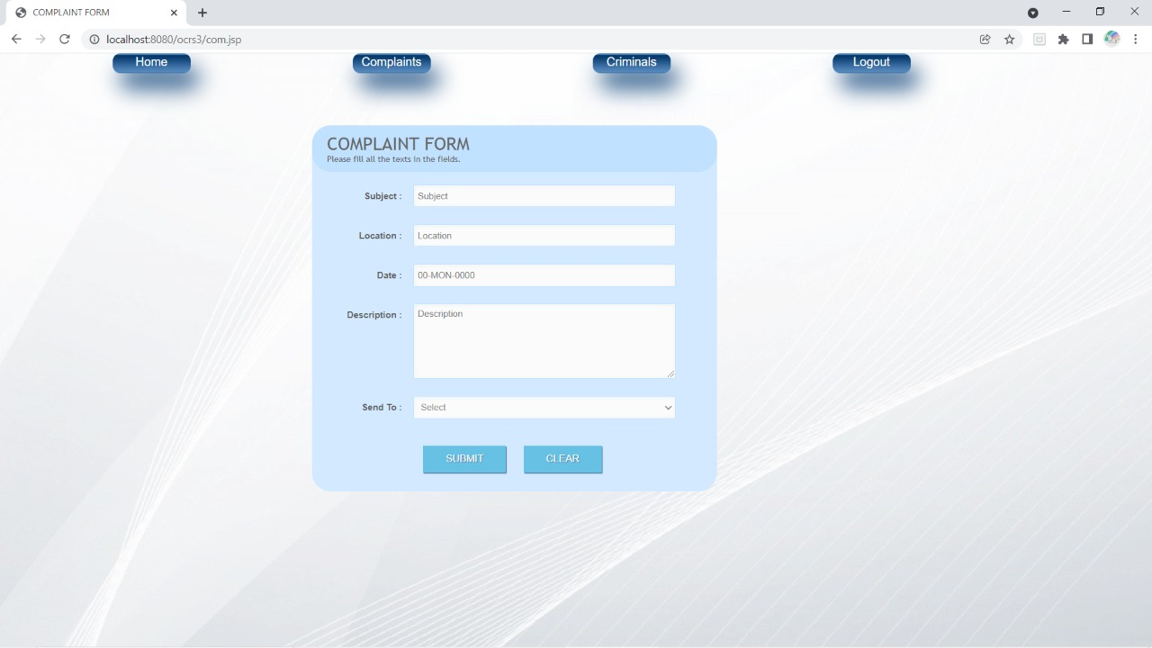
Fig Complain Form

Slide 30
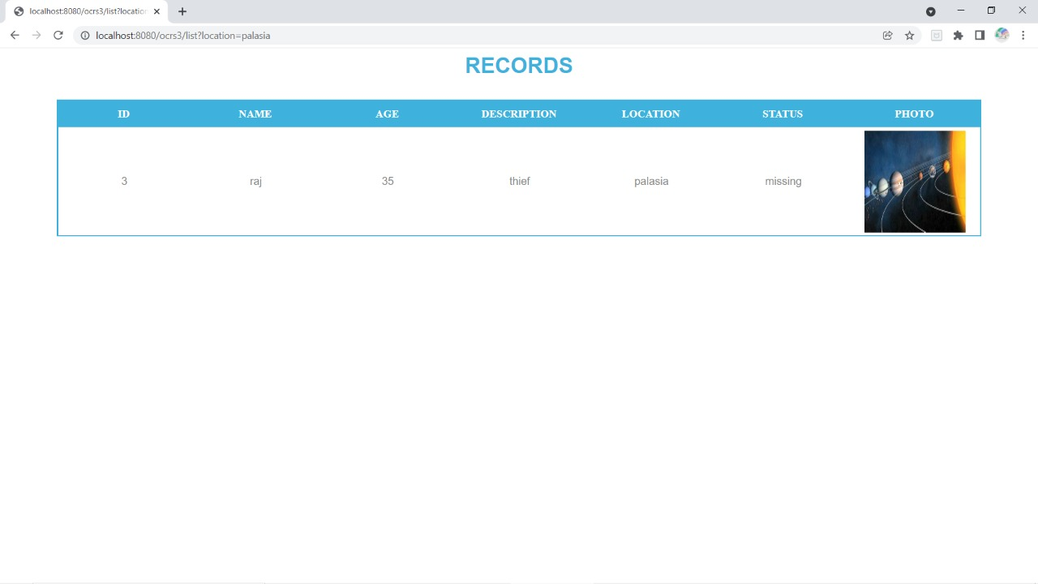
Fig Criminal Records

Slide 31
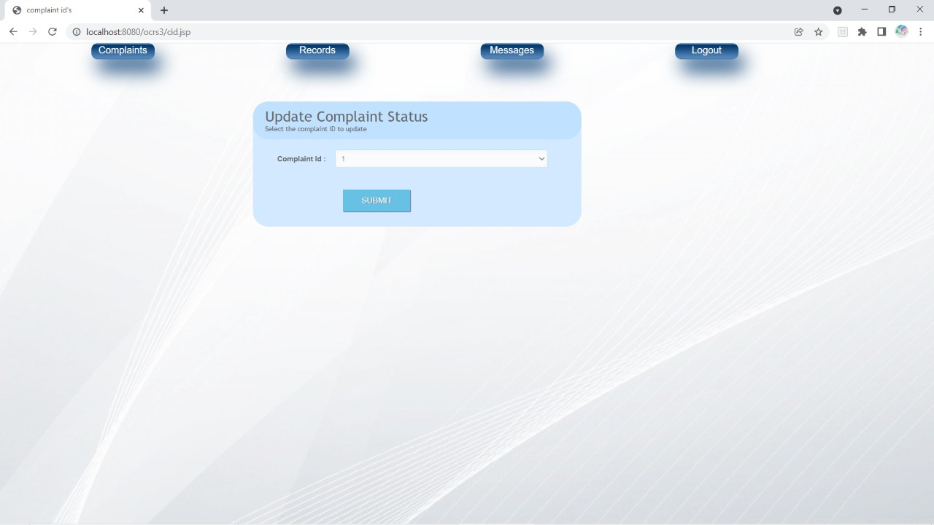
Fig Complain Status

Slide 32
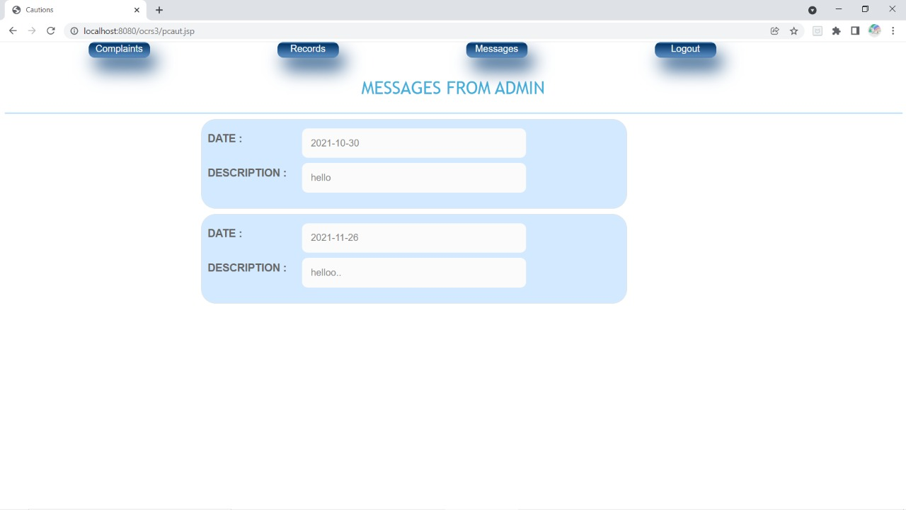
Fig Message from admin

Slide 33
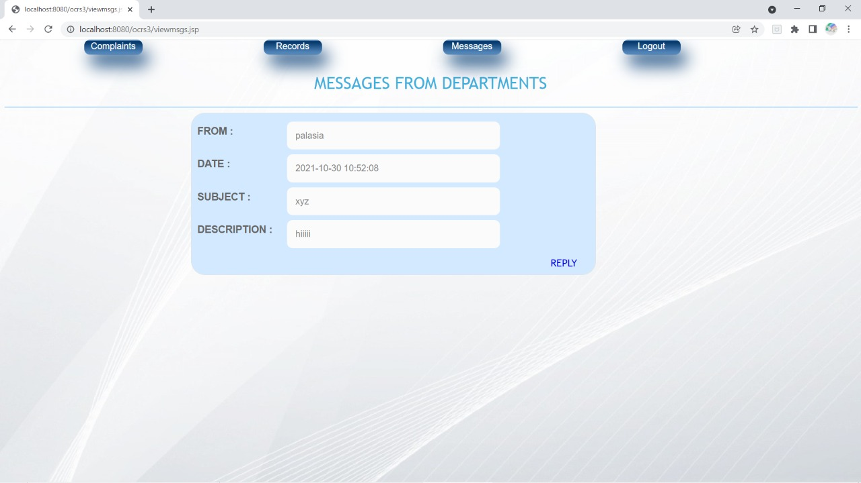
Fig Message from Department

Slide 34
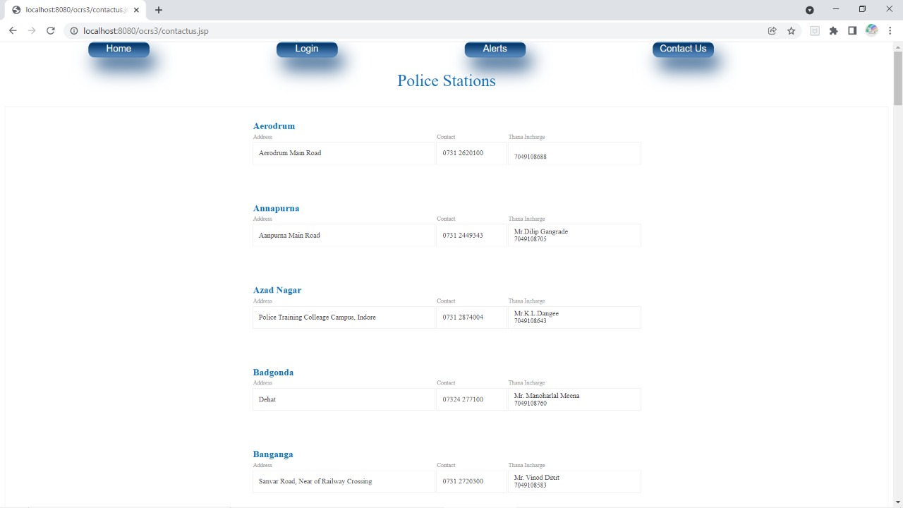
Fig Contact Us

Slide 35
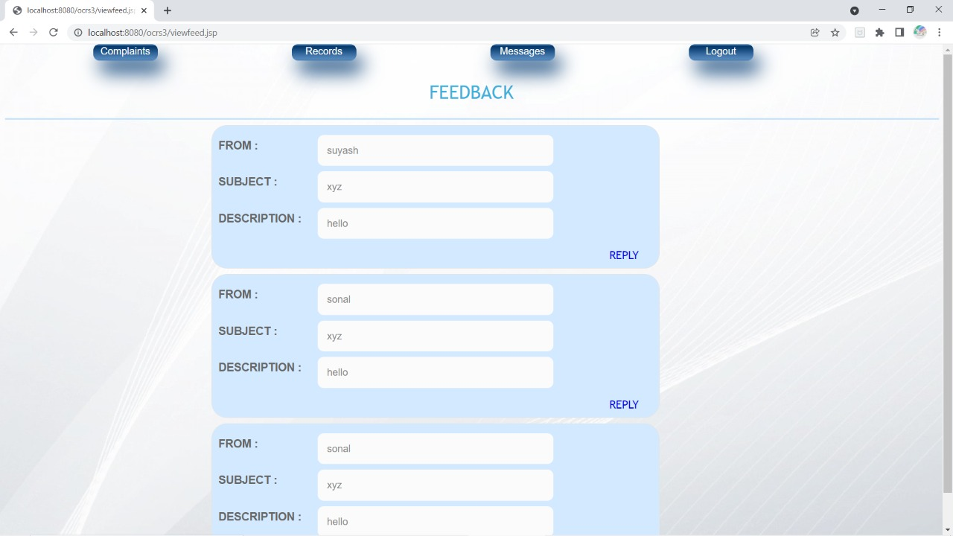
Fig View Feedback

Slide 36
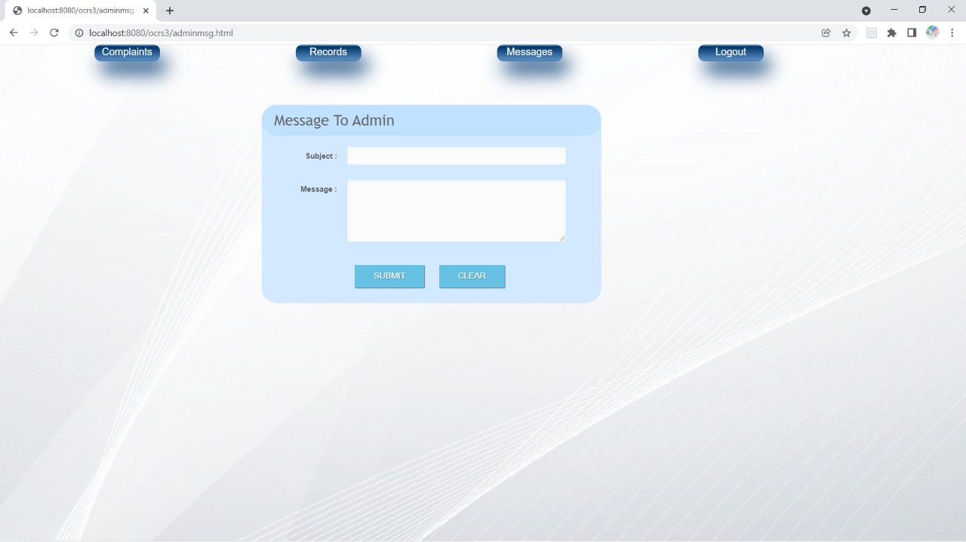
Fig Message to Admin

Slide 37
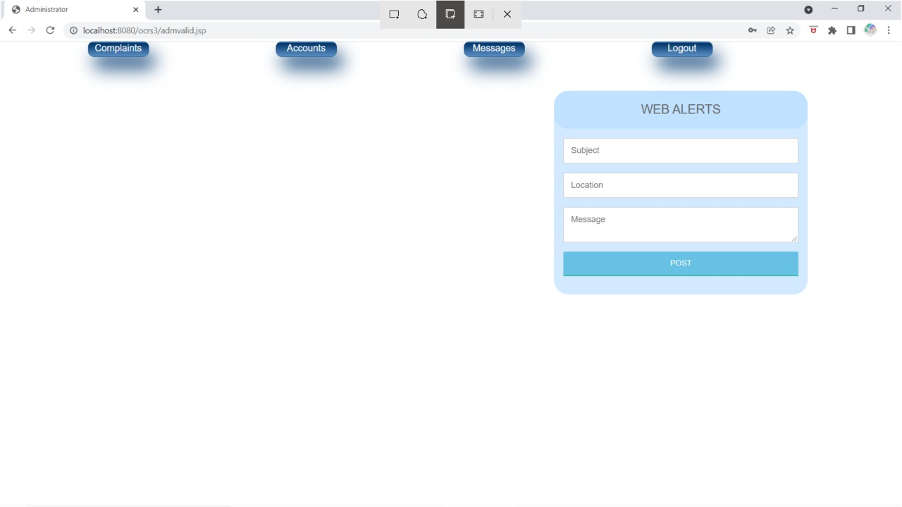
Fig Web Alert

Slide 38
Q&A

Slide 39
THANKS

